Slide 1
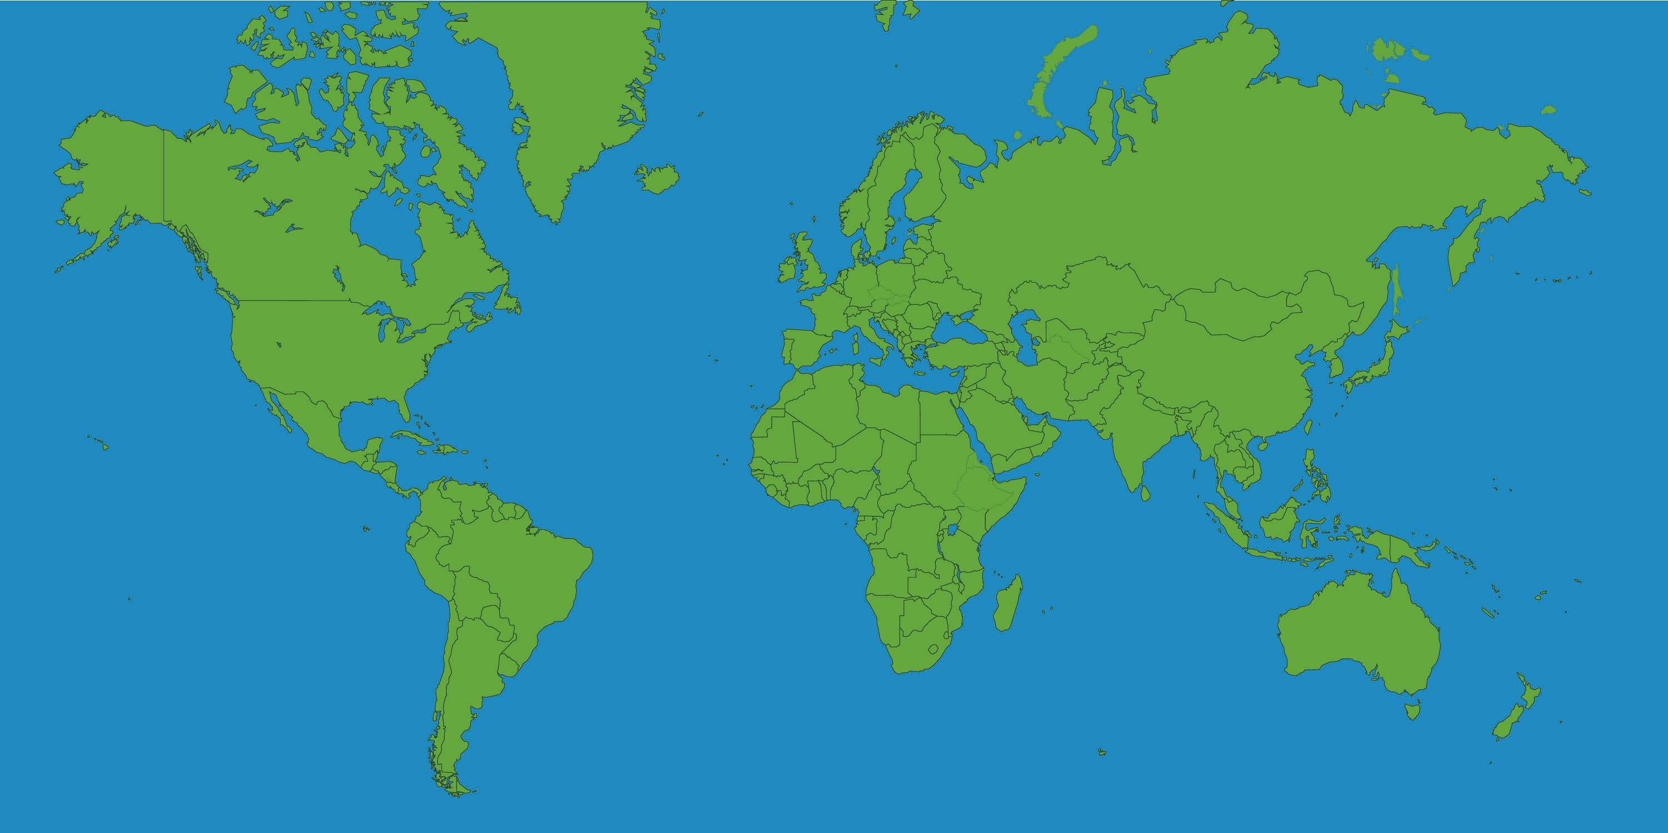
Countries and their cultures
This week’s topic is Countries and their cultures. We are going to learn about different countries, the continents they lie in and their cultures including their national sports.

Slide 2
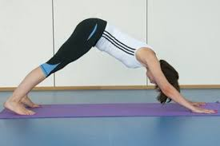
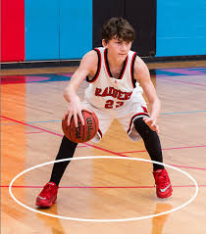
Activity | Resources | Potential Risks | Impact
Yoga | Yoga mat. Access to the video on slide 4. | Uneven surface. Ensure this is done on a flat surface. Do the activity barefoot for safety reasons. | Children to learn stress-relieving and relaxation method
Basketball Dribbling | A large ball that bounces well | Make sure this is done on a flat, even surface. | Children to learn how to dribble a basketball with control.

Slide 3
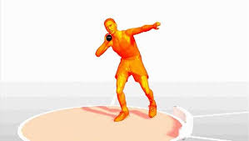
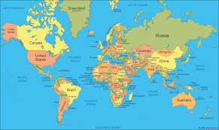
Activity | Resources | Potential Risks | Impact
Shot Put | Tennis ball Tape Measure. | Ensure the arms are warmed up properly. | Children to learn the correct technique of putting (throwing) the shot put.
Countries Competition | Pieces of Paper Pens/Crayons | None | Children to learn about a country of their choice

Slide 4
Yoga and Mindfulness
Where was Yoga developed?
What are the Health benefits of yoga?
How Does Yoga make you feel after you have completed a session?

Slide 5
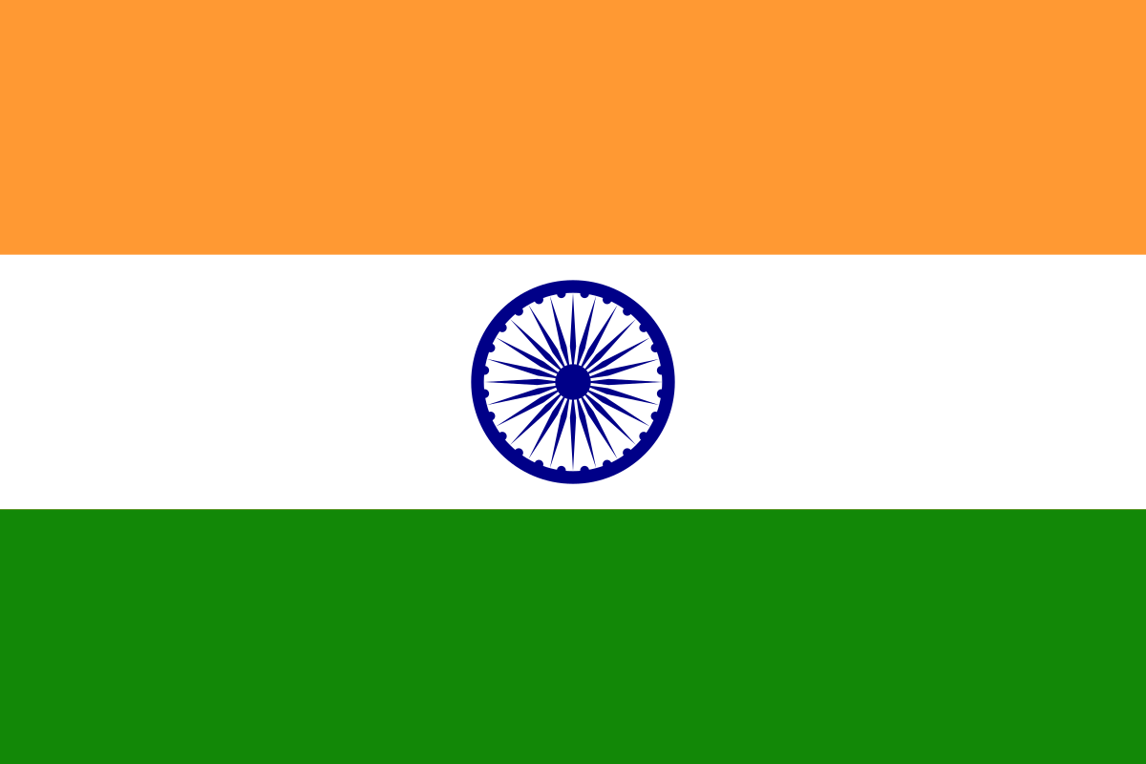
Extension Task (Y5/6)
Yoga originated from India. The background of this slide is the Indian National Flag. How good is your knowledge of India? Have a go at the questions below:
1. What is the capital of India?
2. What is the currency of India?
3. India is located on which continent?
4. India is the most populated country in the World. True or False?
5. Which of the 7 wonders of the world is located in India?
This Photo by Unknown Author is licensed under CC BY-SA

Slide 6
Basketball
Basketball was invented in 1891 by James Naismith, a Canadian Clergyman.
Basketball is the National Sport of Lithuania, Estonia and Serbia, but is also very popular in the USA and Canada.
Are you able to name 3 famous basketball players (past or present)?
Resources you can use – Internet and books

Slide 7
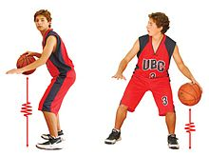
Basketball Dribbling
Have a basketball (or a large ball that bounces well).
See how many times you can bounce/dribble a basketball in 60 seconds.
Tips.
Bouncing the ball using fingertips consistently
Keep control of the ball while moving
Using correct body stance to dribble – Bent knees. Feet shoulder width apart.
Keep possession of the ball confidently without losing control of the ball
Beat the Teacher
Mr Jarad of Primary Sports attempted this challenge and he scored 97 bounces with his stronger hand, 99 bounces with alternate hands, and 80 bounces with his weaker hand. Can you beat his scores?
Extra Challenge
Repeat the process but use alternate hands when dribbling. Then you can dribbling the ball using only your weaker hand. Remember the tips shown above.

Slide 8
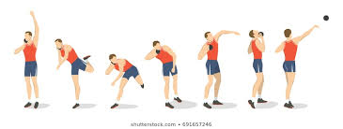
Shot Put
What is Shot put? What are the world records for Men's and Ladies? What material is used to design the shot put and what is the weight (Men's and Ladies) ?
For the sake of this activity, use a tennis ball.
See how far you can put/throw the tennis ball using the correct shot put technique. Set up a tape measure and have the child place their feet shoulder width apart with their left foot (right foot if the child is left handed) on 0cm. When scoring, the score is taken where the tennis ball lands first (not necessarily where the ball ends up). Have 5 attempts and record your best score.
Tips
Start weight on back foot
Place ball under your chin, as shown in the image on the right.
Bend knees to give a low stance
Push forward with legs and extend arm to give power
Release at highest point
If you are unsure, look at the image on the right.
Extra Challenge
Repeat the process but put/throw with your weaker hand. Remember the start position mentioned above is reversed and you start facing in the opposite direction.
Beat the teacher.
Mr Jarad from Primary Sports attempted this challenge and he scored 8.5m with his right hand and 5m with his left hand. Can you beat his scores?

Slide 9
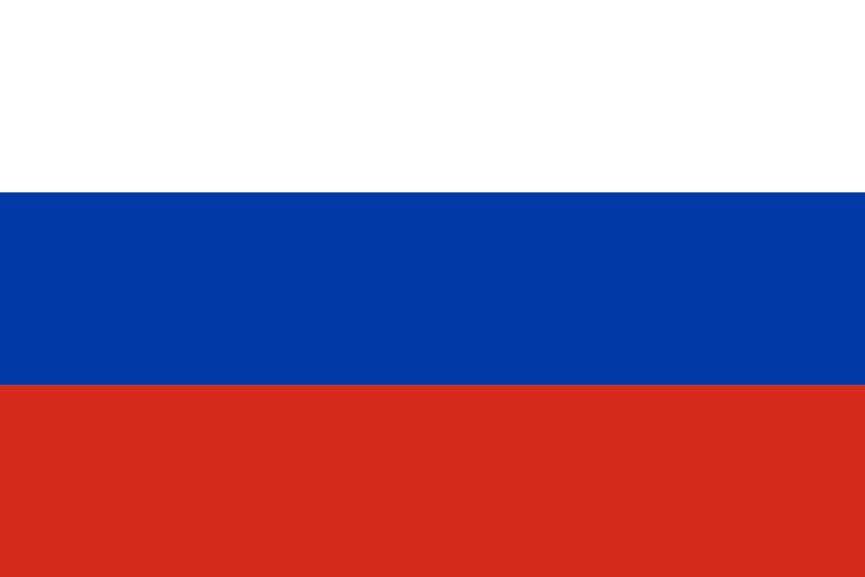
Extension Task
Y3/4
The men’s world record for the shot put is 23.12m, set by American athlete Randy Barnes in 1990. Can you answer these questions on the USA?
What is the capital city of the USA?
Who is the current president of the USA?
How many states make up the USA? (Hint, count the number of stars on the flag).
The USA is part of which continent?
Y5/6
The women’s world record for the shot put is 22.63m, set by Russian athlete Natalya Lisovskaya in 1987. Can you answer these questions on Russia?
What is the capital city of Russia?
Name the 2 continents that Russia is part of?
Does Russia have a president or a monarch (King/Queen)?
What is their name?

Slide 10
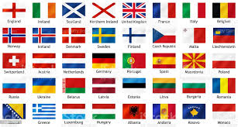
Countries Competition.
Pick a country of your choice. It can be any country in the world (the more obscure the better). Create your own poster displaying as much information as possible about that country on there (including pictures and drawings). Below are some things to think about when designing it. It would be great if you add in more information!!
What is the capital city of that country?
What is that country’s National Sport?
What is that country’s National Flag?
Are there any famous landmarks in that country?
On which continent is that country located?
Can you name any animals that are native to that country?
Does that country have a President or a Monarch?
Email your posters to:
james@primary-sports.co.uk
There are prizes up for grabs for the best Y3/4 poster and the best Y5/6 poster.

